Slide 1

Real Estate Property Listing System
Name: Shahriar Hosen
ID: 1910032
Organization: IT WAY BD
Summer: 2025
Academic Supervisor: Asif Mahmud

Slide 2
Objective & Motivation
Develop a centralized, secure, and user
The motivation is to move away from fragmented and outdated systems.
Goal is to improve efficiency, trust, and accessibility for all stakeholders.
Build Trust
Improve Efficiency
Centralized Platform
friendly property listing platform.

Slide 3
Problem Statement
Manual Processes | Property dealings rely on inefficient, manual processes.
Lack of Centralization | No single, reliable platform for all property information.
Misleading Information | Property details are often incomplete or misleading.
Trust Issues | Weak verification processes lead to significant trust issues.

Slide 4
Technology Uses.
PHP, Laravel
HTML, CSS, JS, Bootstrap
MySql
Development Tools: Visual Studio Code, XAMPP, Github

Slide 5




Key Features
Role-Based Access
Approval Workflow
Separate dashboards for Admin, Seller, Agent, and Buyer roles.
Structured process for property listing verification and approval.
Advanced Search
Secure Authentication
Comprehensive filtering and search capabilities for users.
Robust authentication and secure data handling protocols.

Slide 6










Methodology
We adopted an Agile development approach, focusing on iterative design, coding, and testing to ensure flexibility and rapid feedback.
UI/UX Design
Requirement Gathering
Implementation
Deployment (Local)
Testing

Slide 7
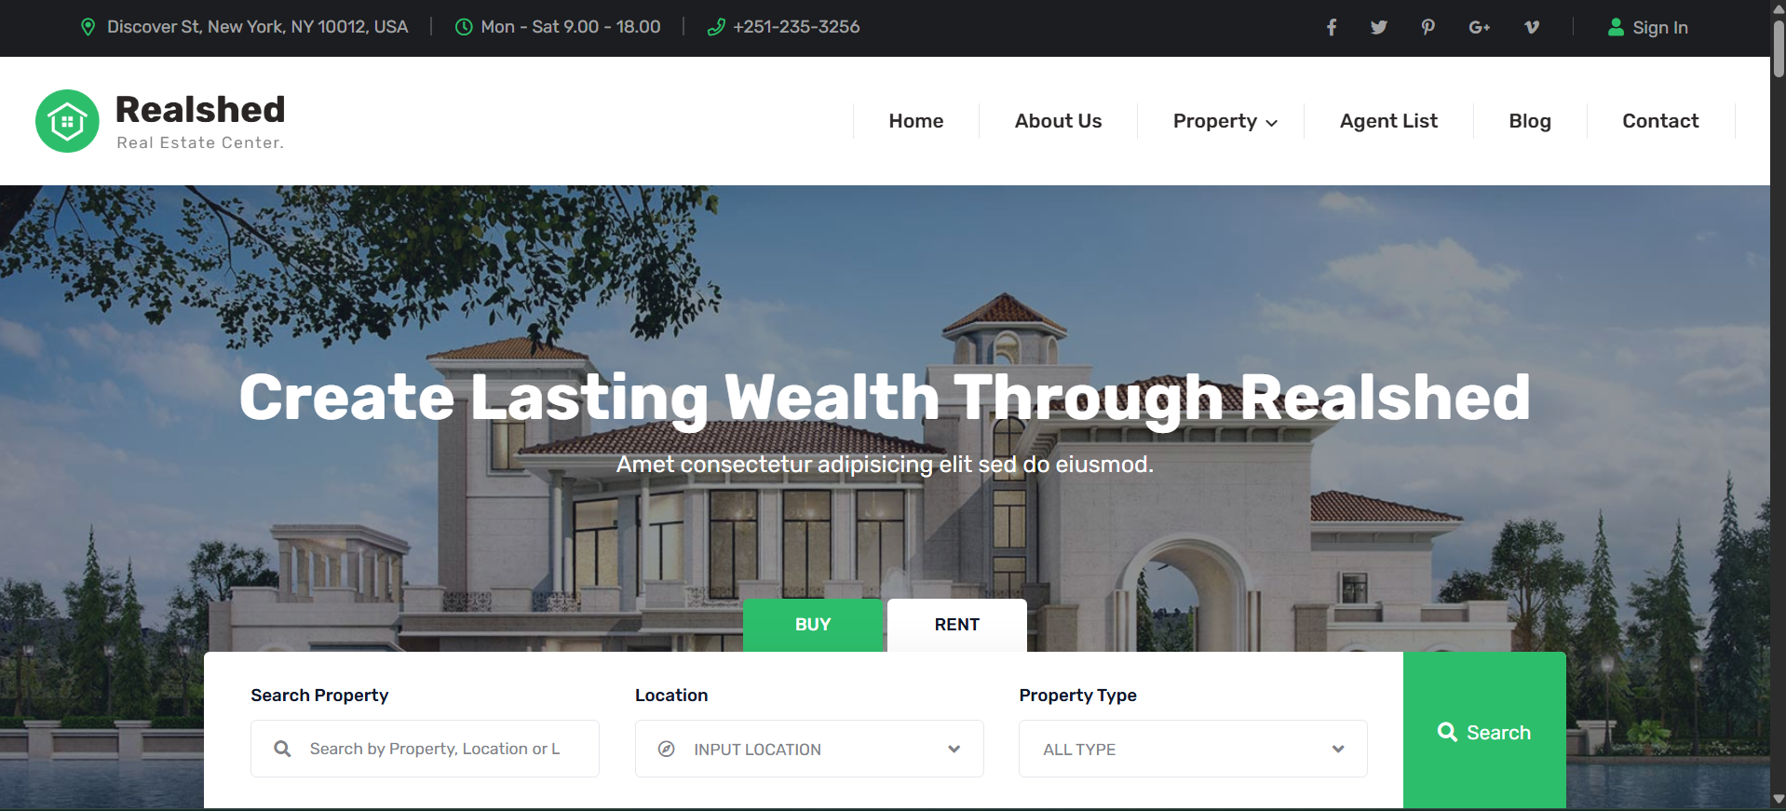
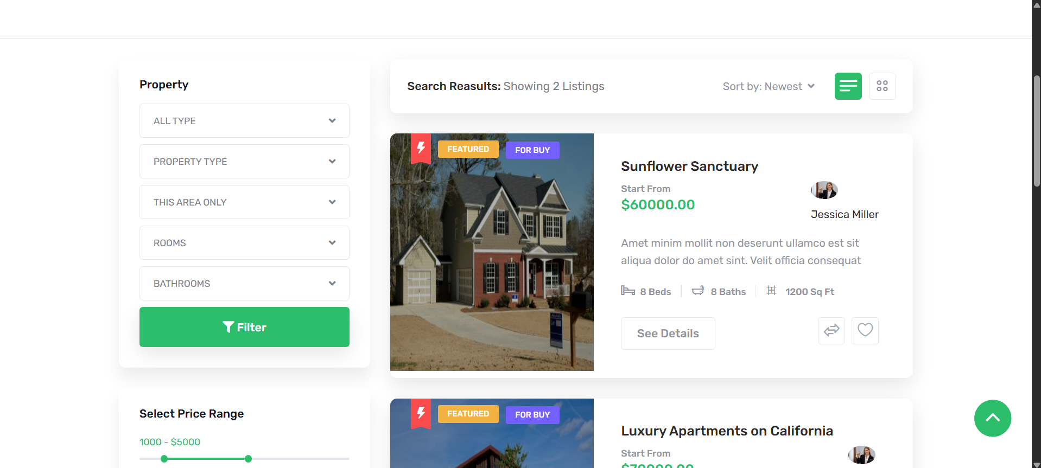
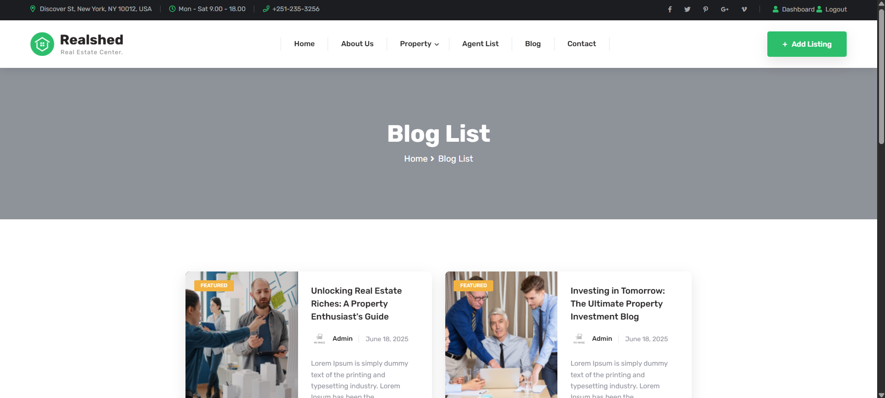
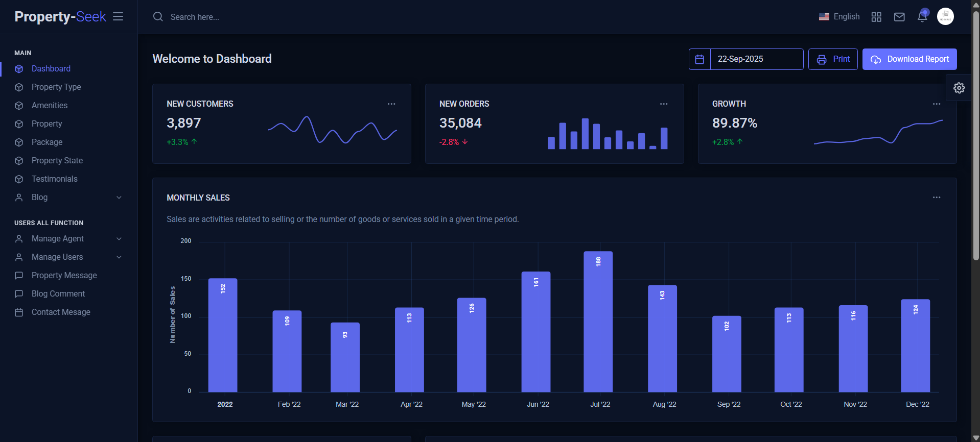
User Interface (UI)

Slide 8
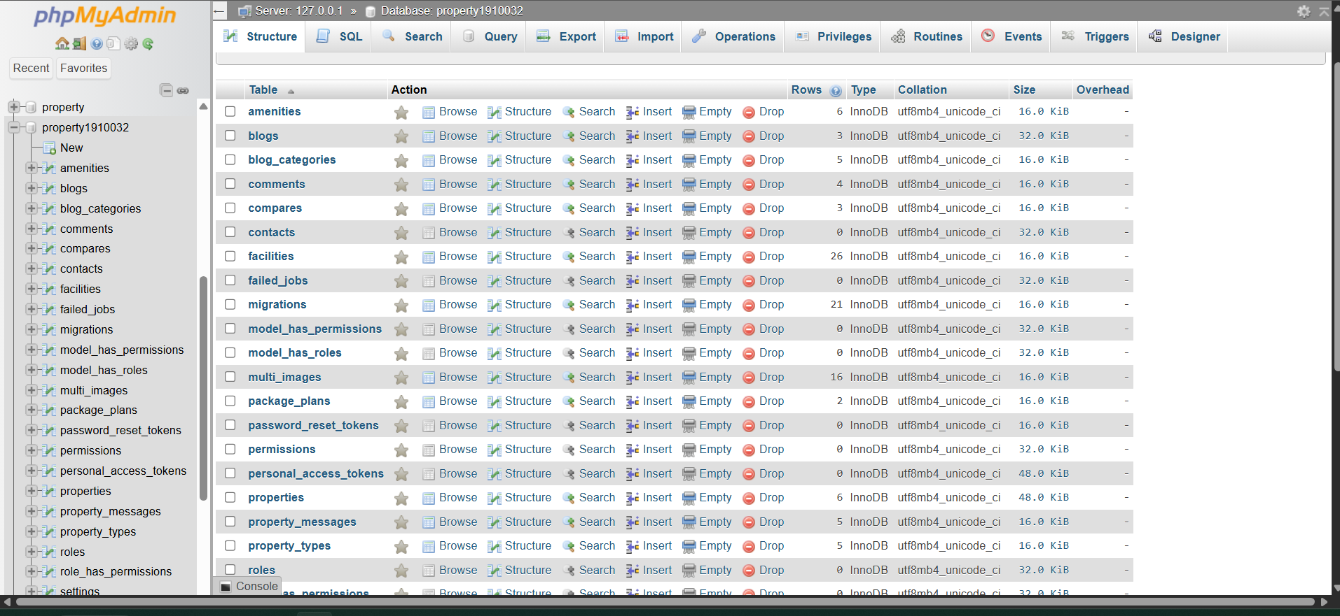
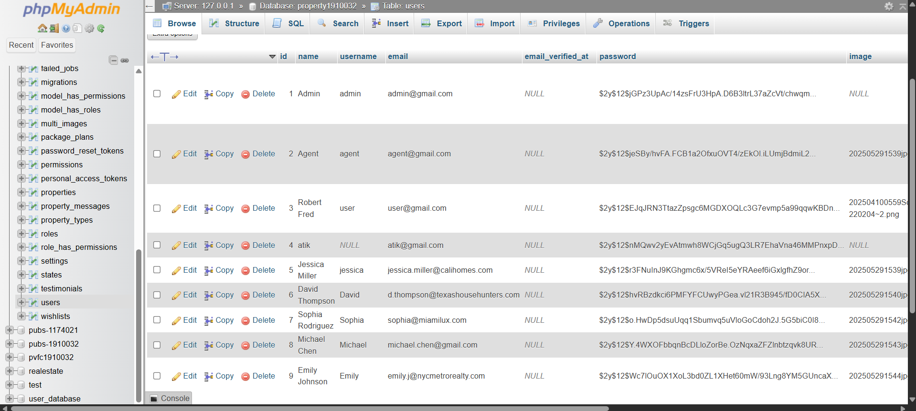
Database (XAMPP)

Slide 9
Results
99.99%
Fast
Scalable
Responsive
Test Cases Passed
Property Search
Web Platform
Tested On multiple Devices
All critical test cases, including login, search, inquiry, and security checks, were successful.
Delivered fast and reliable property search and filtering capabilities.
A functional and scalable web platform was successfully delivered.
Responsive design for multi device access

Slide 10

Challenges Faced
Scalability and performance optimization for handling large datasets.
Addressing data security concerns (e.g., SQL injection, unauthorized access).
User adoption and training for stakeholders accustomed to manual systems.
Software related issue for example XAMPP was crashing often.

Slide 11
Conclusion & Future Work
The Real Estate Property Listing System successfully bridges the gap between buyers, admin and agents by offering a secure, user-friendly, and centralized digital platform. It not only modernizes property management but also demonstrates the practical application of academic knowledge in solving real-world challenges. During my internship, I got a real understanding of how a company works and how teams collaborate in a professional environment. Overall , This experience improved both my technical skills and teamwork.
Future Work
Payment integration
Map-based property search
Dedicated Mobile Application
AI-Based Recommendation Engine
Deployment on live servers

Slide 12
THANK YOU
Shahriar Hosen
ID: 1910032
1910032@iub.edu.bd

